Slide 1

Potato Leaf Disease Detection using Dense Convolutional Neural Networks (D-CNNs)
Naser Alkuhili

Slide 2

Problem Statement and Background
Problem Statement: Potato leaf diseases like early and late blight impact productivity and food security. Current manual inspection methods are time-consuming, labor-intensive, and often inaccurate.
Background:
Importance: Potato crops are economically valuable and crucial for food security.
Challenges: Disease detection is difficult due to subtle variations in symptoms​.
01

Slide 3
Project Importance
Agricultural Productivity: Early disease detection prevents crop losses.
Resource Optimization: Automated methods reduce manual labor and pesticide use.
Food Security: Accurate detection helps ensure stable food supplies.
01

Slide 4
Proposed Solution
Dense Convolutional Neural Network (D-CNN):
Dense Blocks: Connect all layers within a block to enhance feature propagation.
Growth Rate: Controls the amount of information added in each layer.
Transition Layers: Reduce dimensionality to prevent overly wide networks.
This model aims to improve feature reuse, reduce vanishing gradient issues, and increase classification accuracy.
01

Slide 5
Model Architecture
Layers:
Input Layer: Receives resized images (224x224 pixels).
Convolutional and Max Pooling Layers: Initial feature extraction and dimension reduction.
Dense Blocks and Transition Layers: Enhance feature propagation and reduce dimensionality.
Global Average Pooling and Dense Layers: Aggregate features for classification.
Output Layer: Three-class softmax activation for final classification of healthy, early blight, and late blight leaves.
01

Slide 6
Implementation Details
Environment: Python, TensorFlow, Keras, and others.
Dataset Preparation:
Source: PlantVillage dataset
Classes: Healthy, Early Blight, Late Blight
Split: Training (70%), Validation (20%), Test (10%)
Preprocessing: Resized and scaled to 224x224 pixels, augmented with flips and rotations.
Training:
Optimizer: Stochastic Gradient Descent (SGD) with a 0.001 learning rate
Loss Function: Sparse categorical cross-entropy
01

Slide 7
Challenges and Solutions
Data Imbalance: Addressed through data augmentation.
Overfitting: Managed with dropout layers and early stopping.
Image Preprocessing: Custom scaling and enhancement functions to improve model robustness.
01

Slide 8
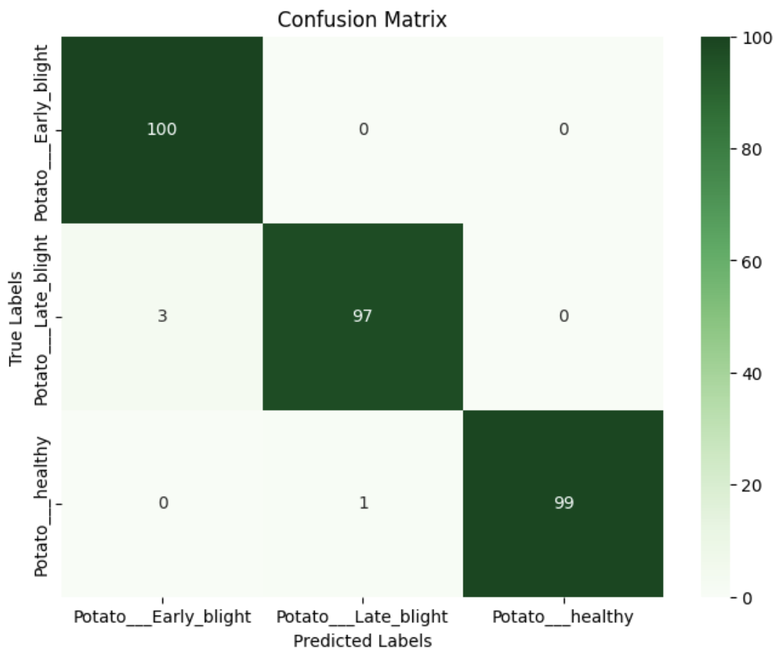
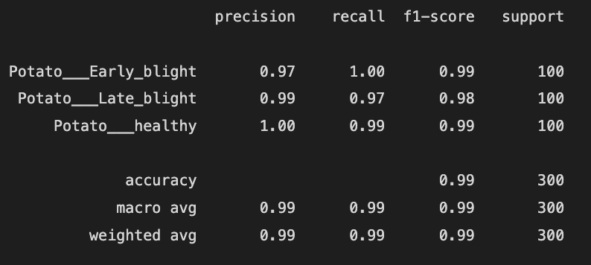
Results
Training and Validation Performance:
Training Accuracy: 98.47%
Validation Accuracy: 99.00%
Test Accuracy: 99.00%
01
Confusion Matrix:
Performance Metrics:

Slide 9
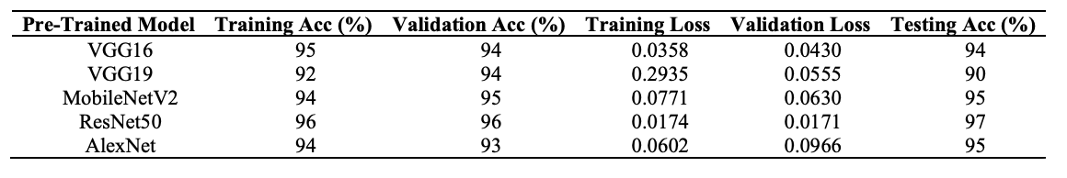
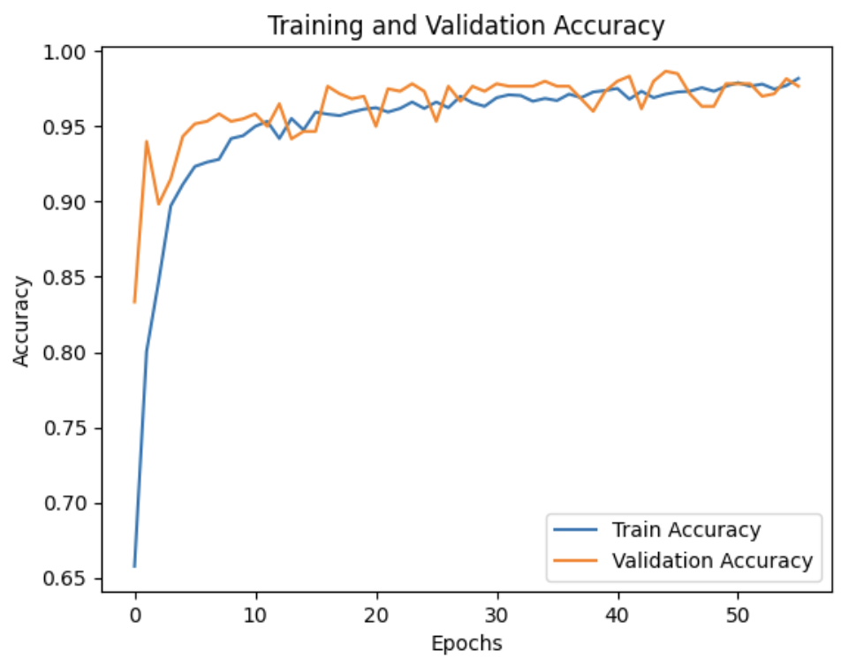
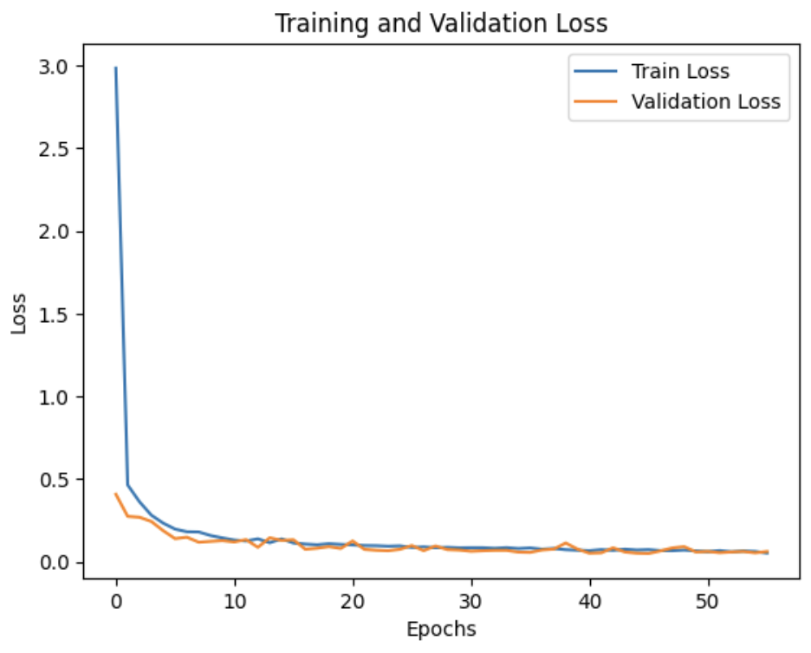
Comparison with Research Paper Models
Main Paper Results:
ResNet50: 97% test accuracy.
VGG16 and VGG19 had lower performance, especially for healthy leaf detection.
D-CNN Performance:
Outperformed ResNet50 with 98.67% test accuracy, demonstrating improved feature extraction and generalization.
01

Slide 10
References
Main Research Paper: Erlin, Indra Fuadi, Ramalia Noratama Putri, Dewi Nasien, Gusrianty, and Dwi Oktarina. "Deep Learning Approaches for Potato Leaf Disease Detection: Evaluating the Efficacy of Convolutional Neural Network Architectures." Revue d'Intelligence Artificielle, Vol. 38, No. 2, April 2024, pp. 717-727. DOI: 10.18280/ria.380236.
Dataset: Hughes, D.P., & Salathé, M. (2015). "An open access repository of images on plant health to enable the development of mobile disease diagnostics." arXiv preprint arXiv:1511.08060. Available at: https://data.mendeley.com/datasets/tywbtsjrjv/1.
01

Slide 11
Thank you!

